Slide 1
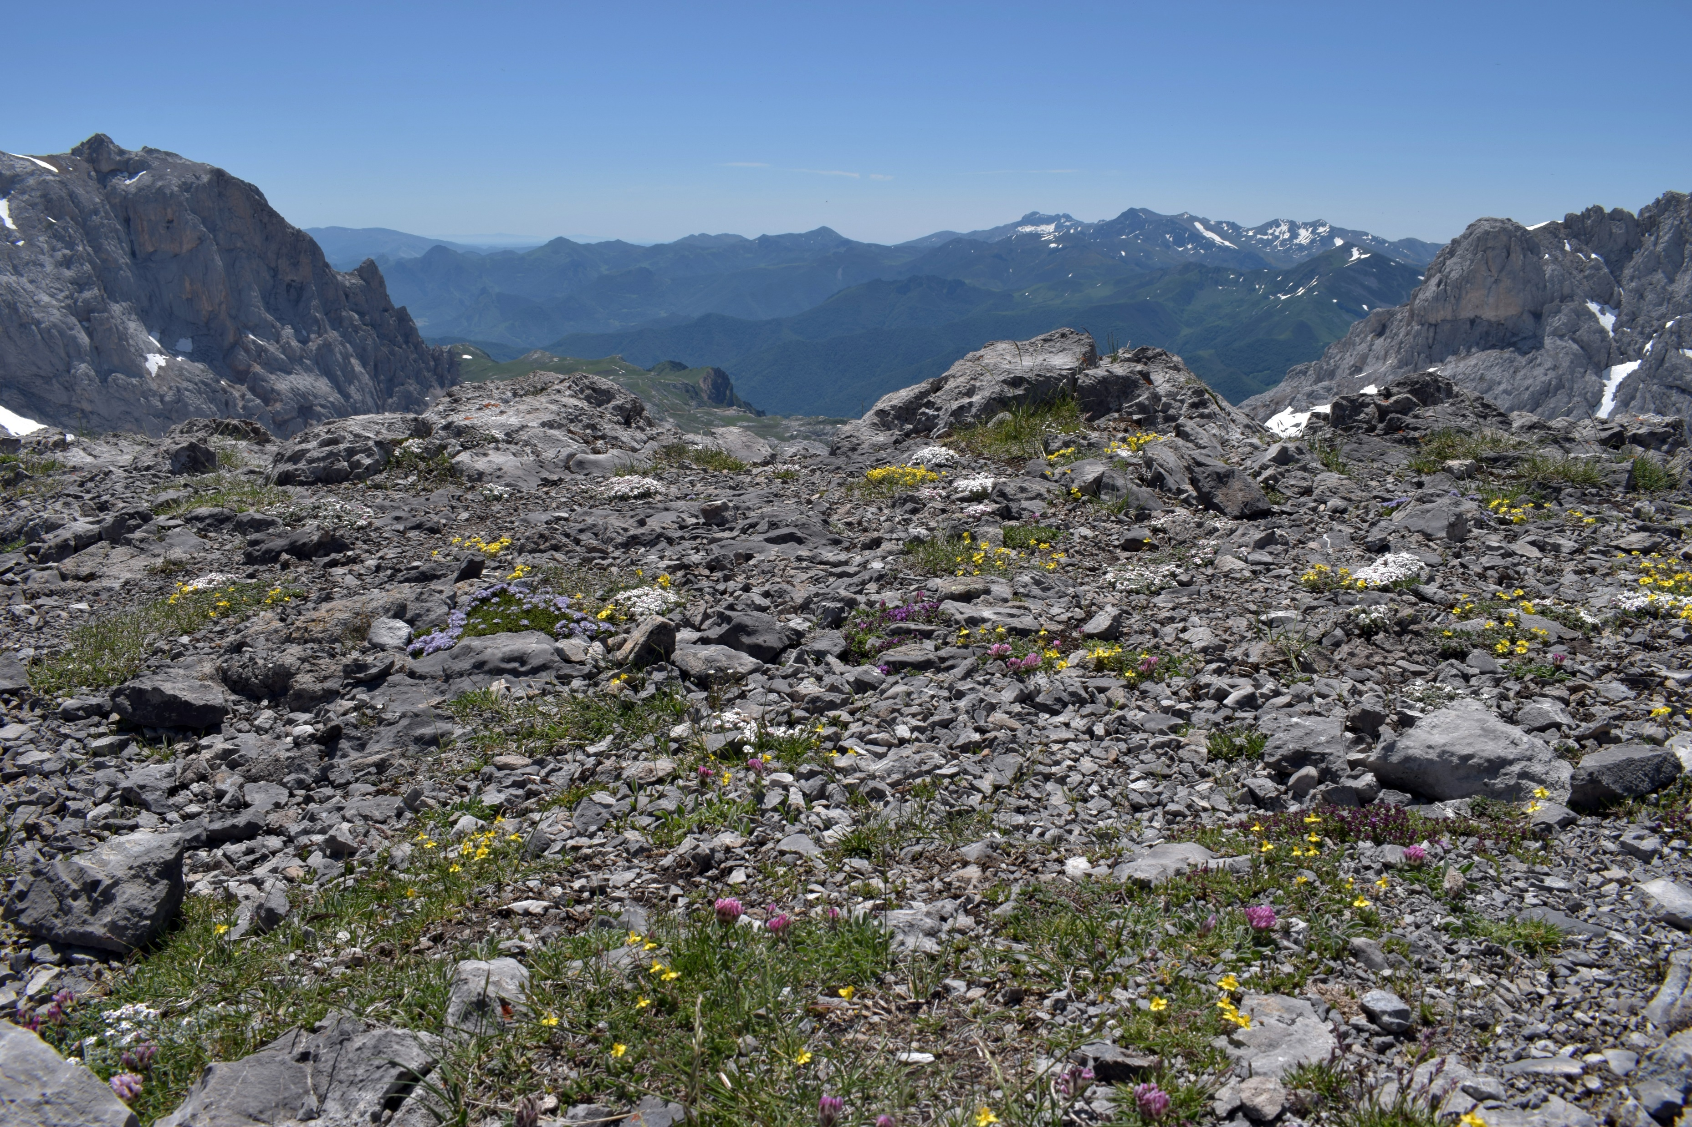

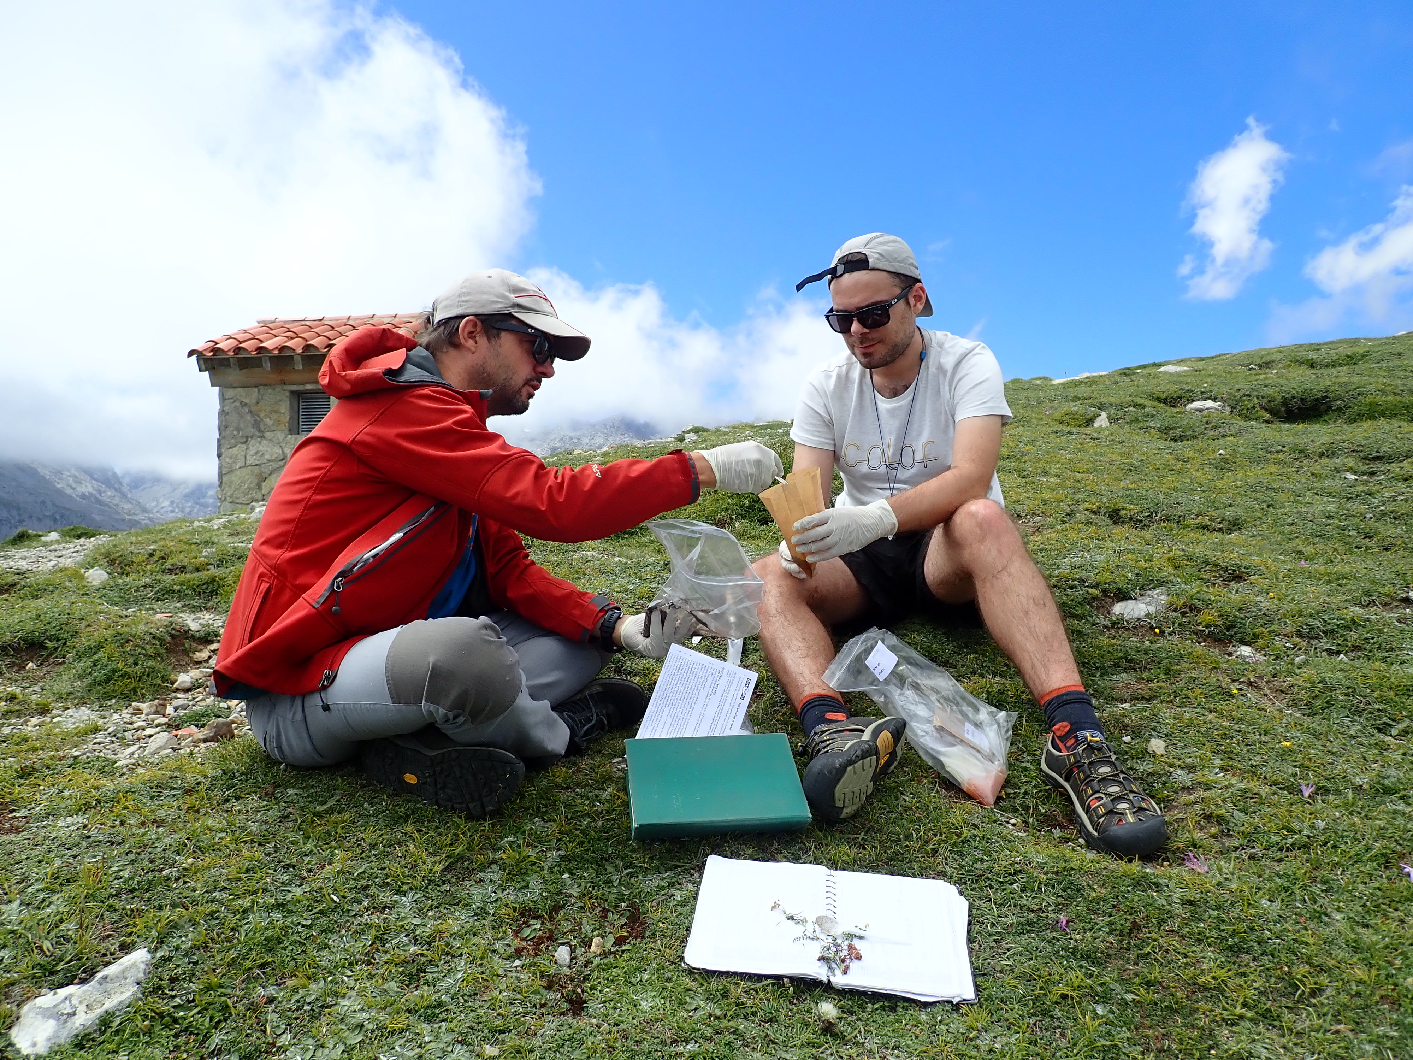
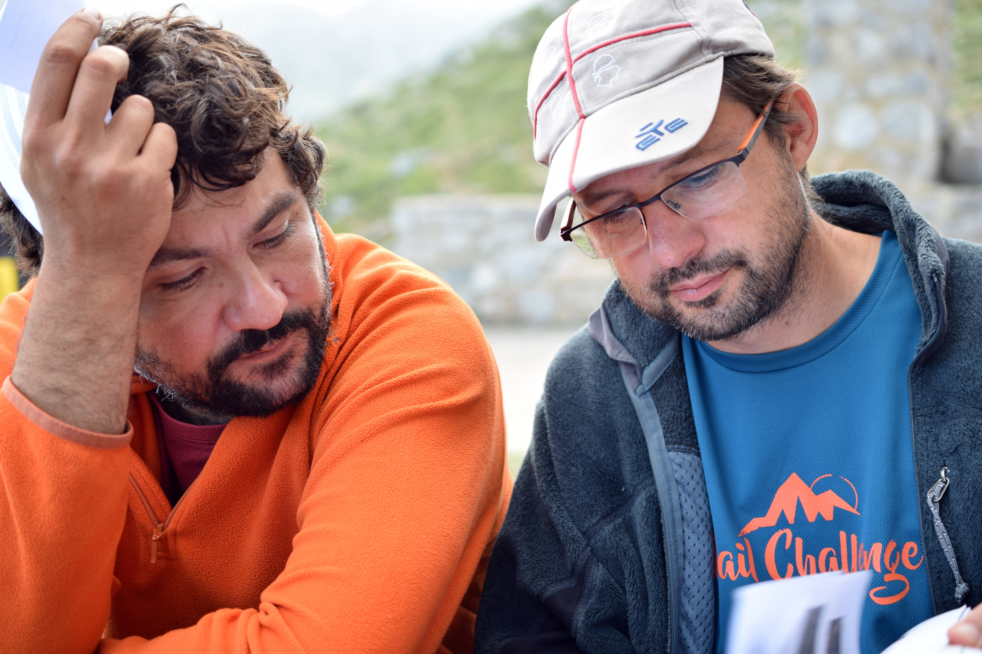




Microspatial models
of plant extinctions
within an alpine species pool
Eduardo Fernández-Pascual
Corrado Marcenò
Borja Jiménez-Alfaro
Biodiversity Research Institute – IMIB
(Univ. Oviedo – CSIC – Princ. Asturias), Spain

Slide 2
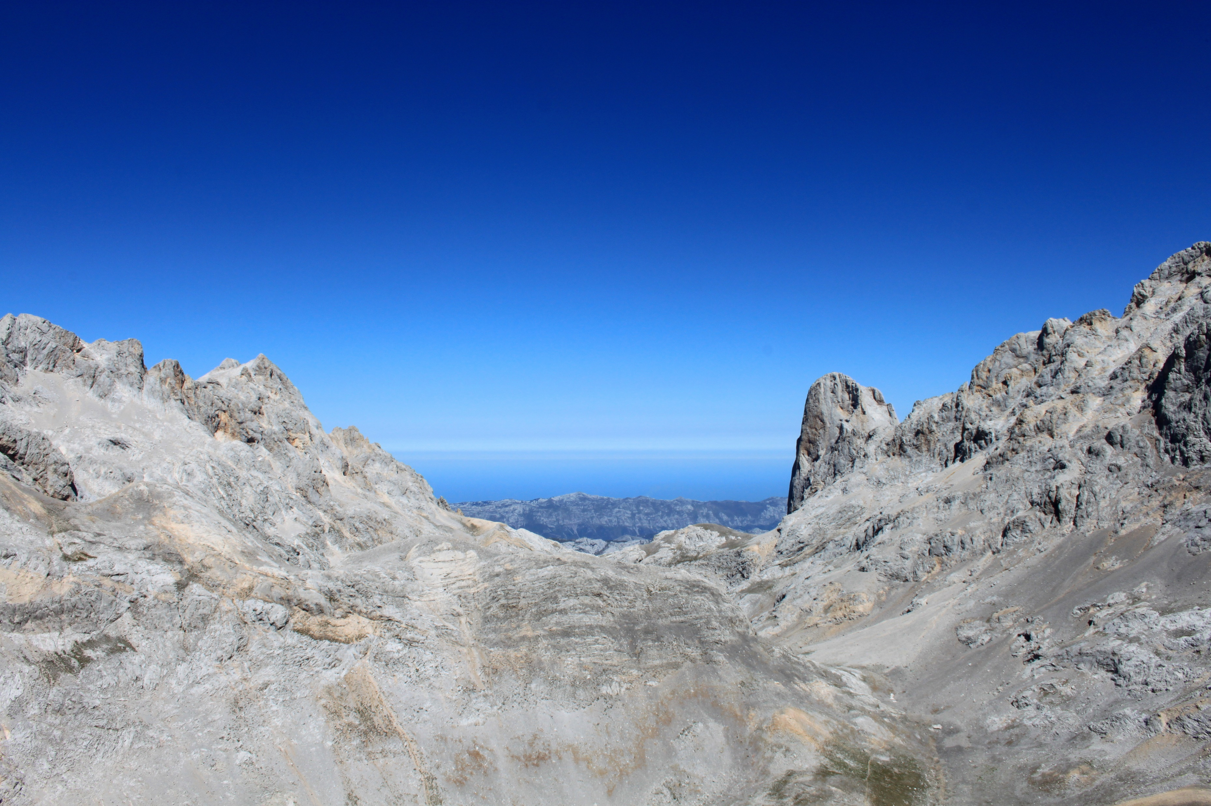
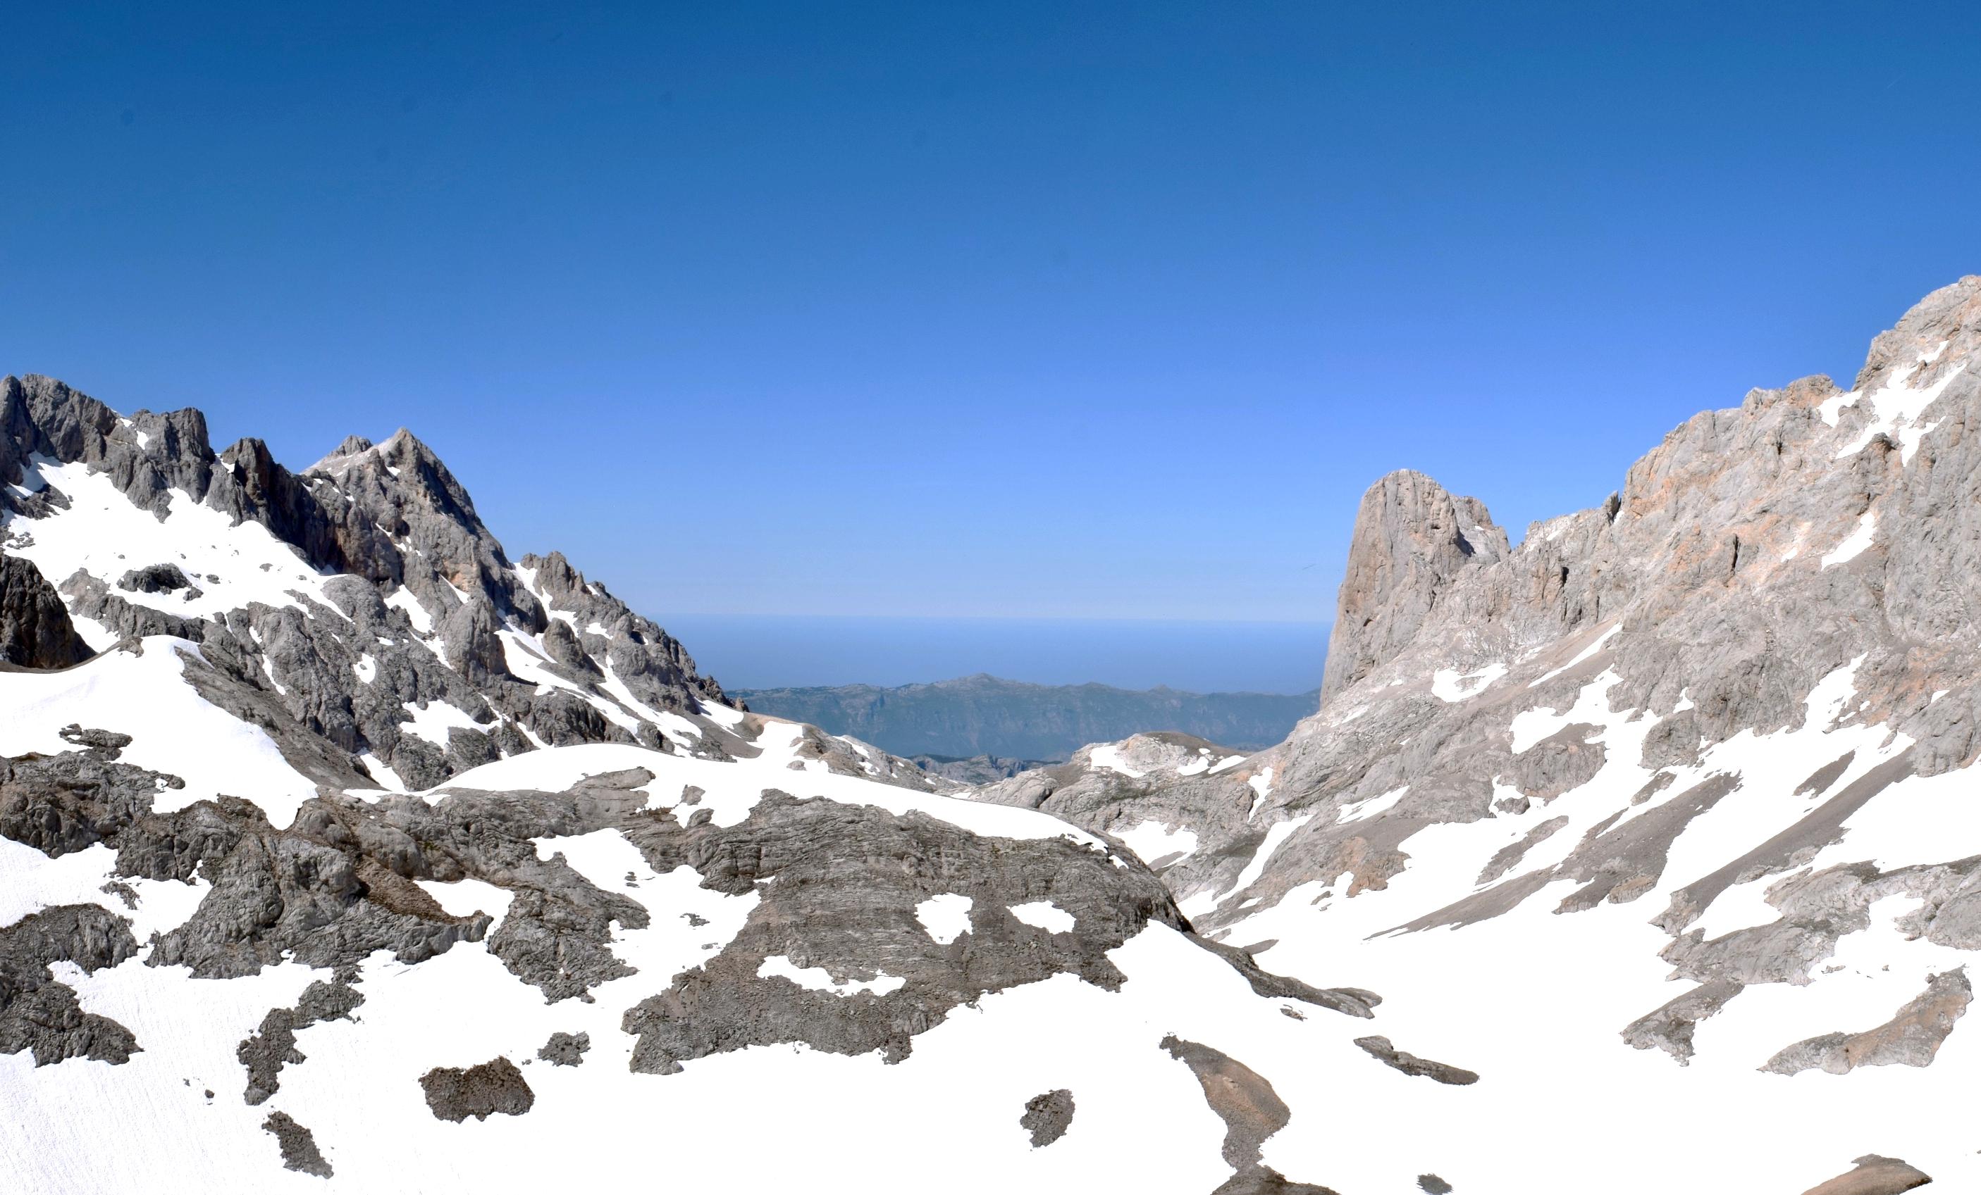

Introduction
Alpine habitats
Alpine habitats occur worldwide, above the treeline
Host cold-adapted floras
Are sensitive to warming?
Are buffered by high microspatial variability?
Summer 2015
Summer 2018

Slide 3
Introduction
Hypotheses
H1 Some alpine species will have a significant association with specific microspatial climatic conditions
H2 Such significant associations can be used to model and predict species responses to microclimatic scenarios

Slide 4
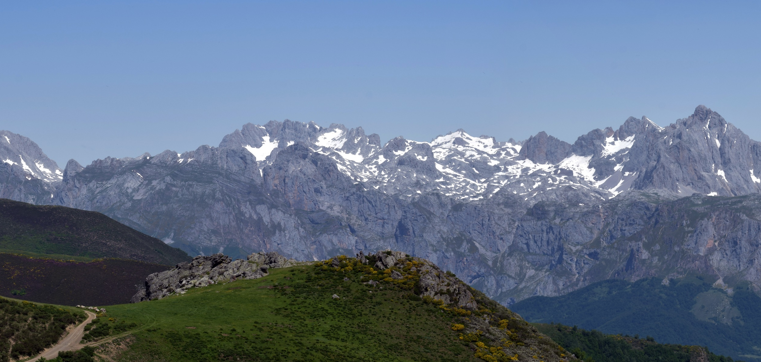
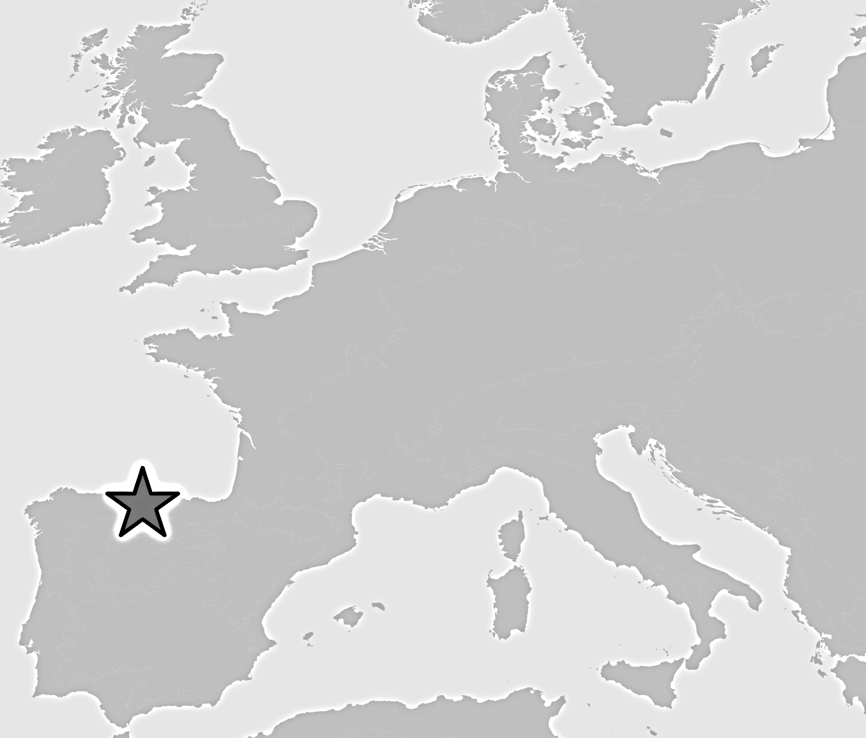

Study system
Los Picos d’Europa, Cantabrian Mts, SW Europe
50 km² calcareous massif
30 km to Atlantic Ocean
Temperate macroclimate
Alpine belt 1900-2400 m asl
Alpine and oromediterranean floras

Slide 5
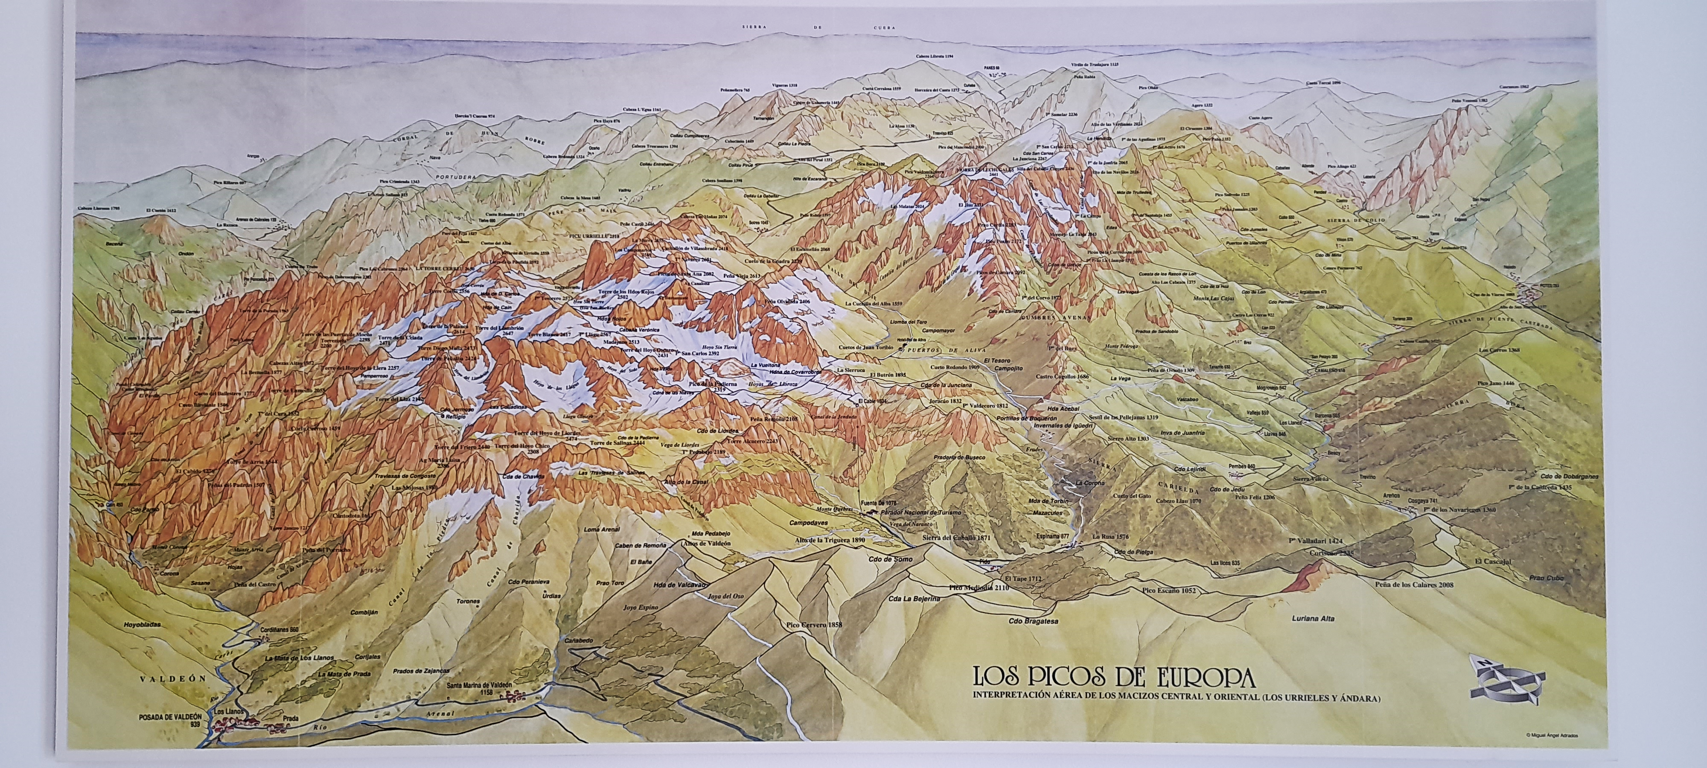
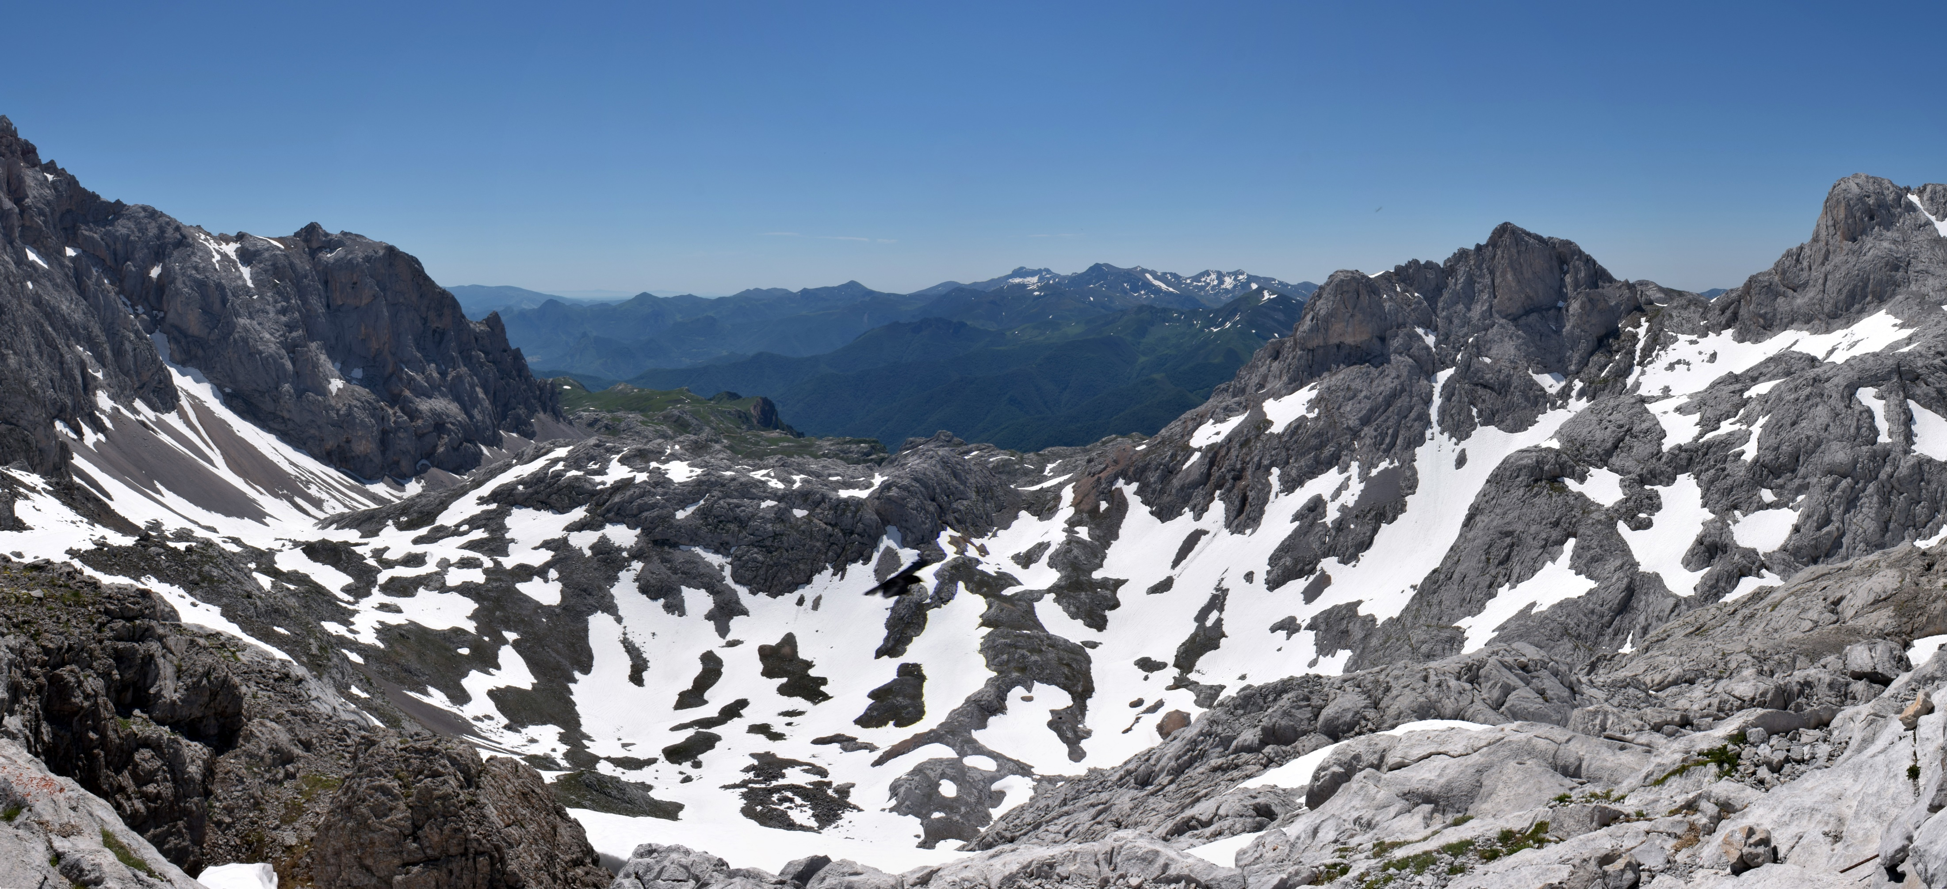
Study system
4 study sites
Los Cazadores
Los Boches
Ḥou Sin Tierri
Hoyo Sin Tierra

Slide 6
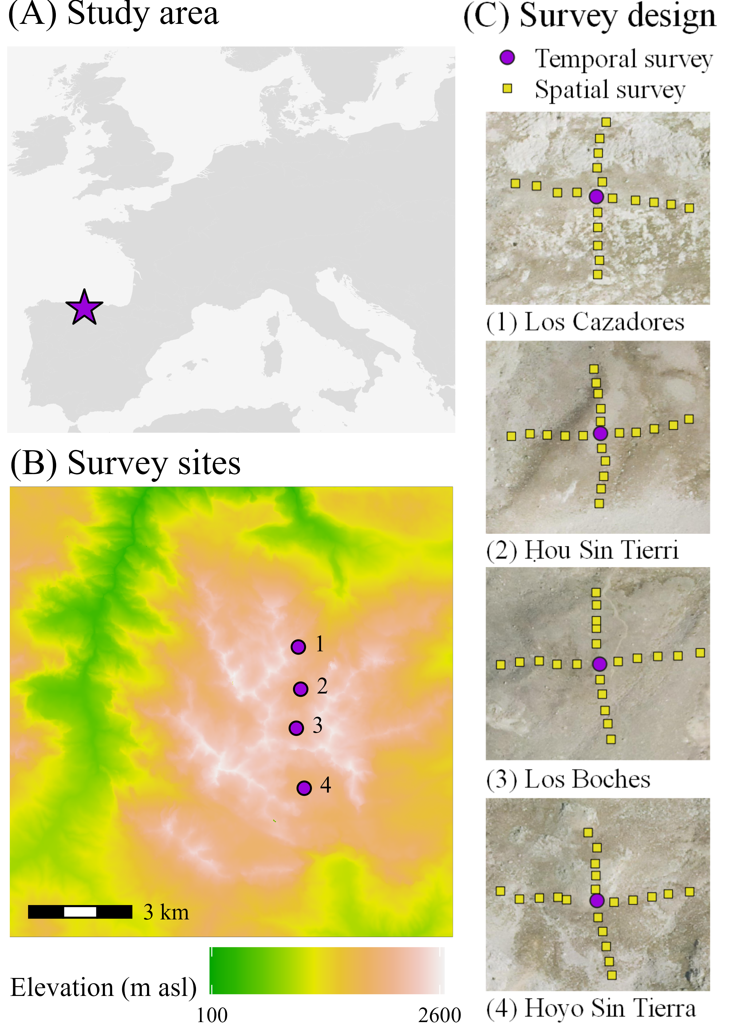

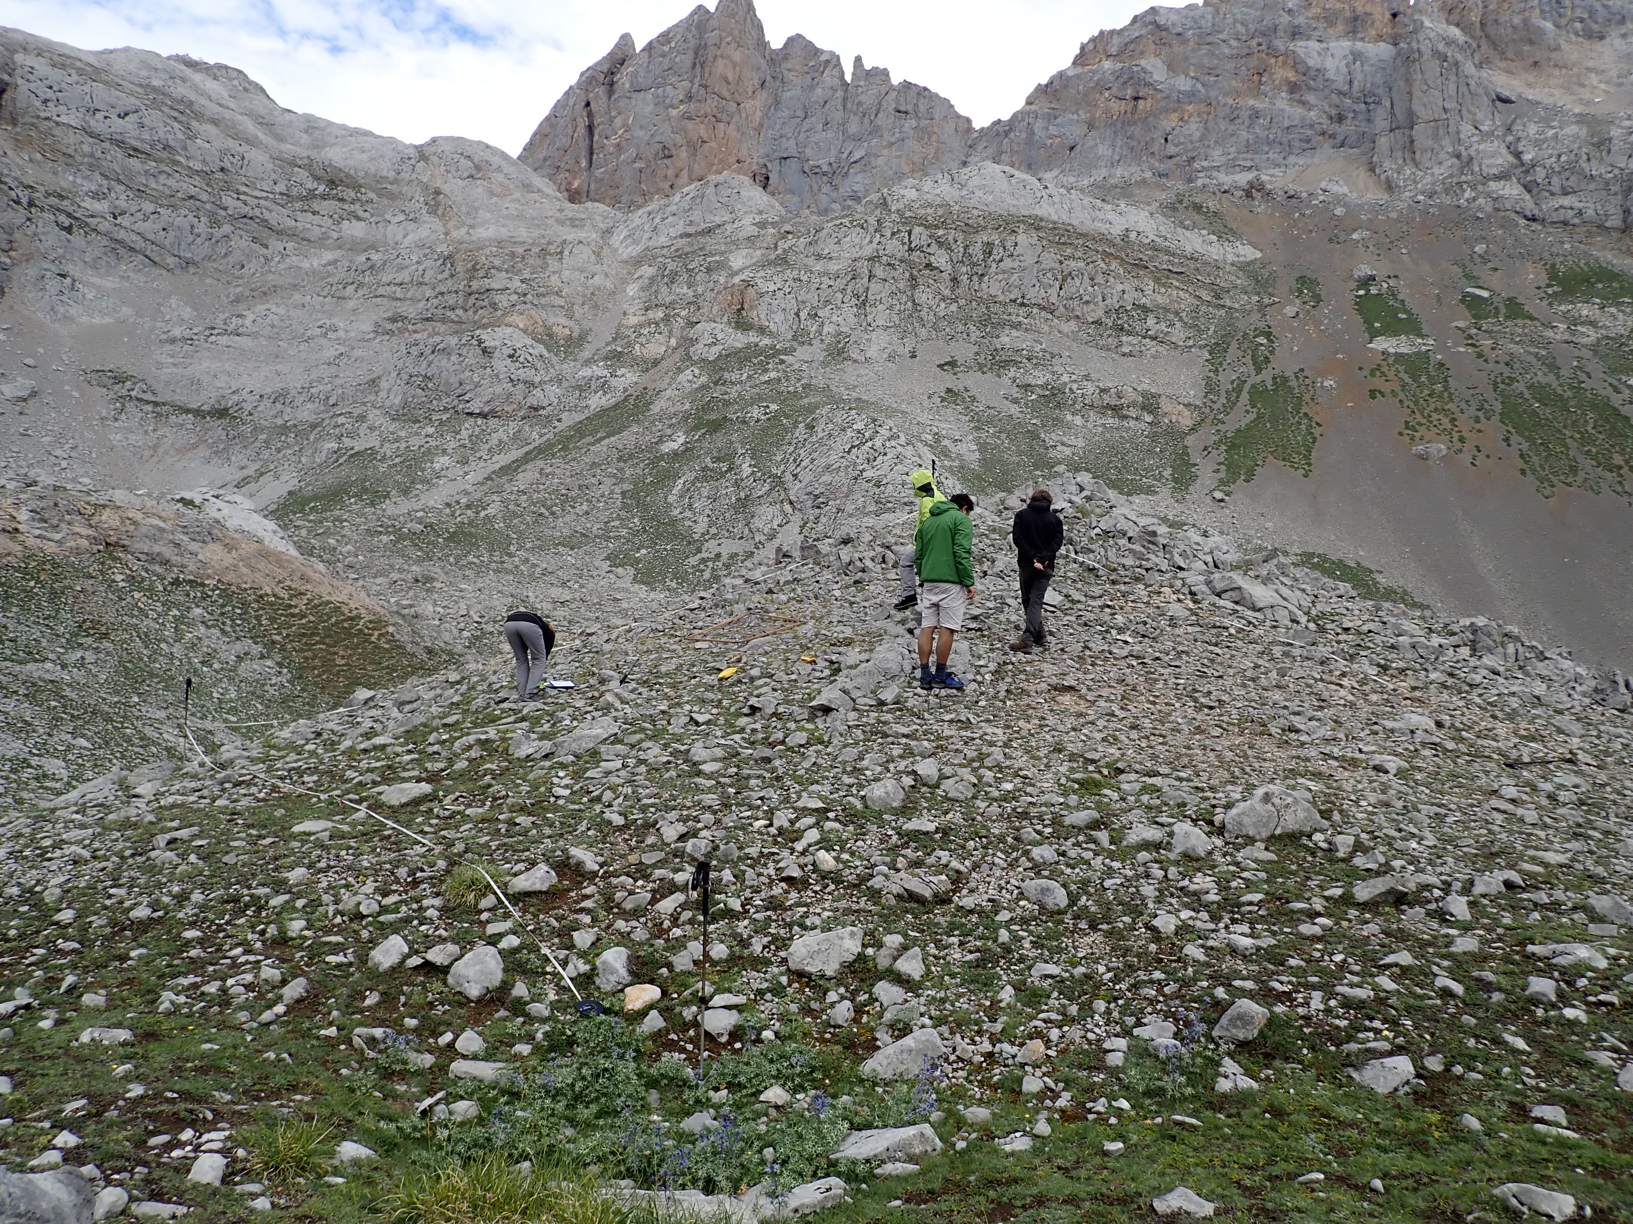
Study system
Temporal and spatial survey
Temporal survey
Central plot per site
10-year soil temperatures
Vascular plants recorded 2009, 2018
Spatial survey
20 plots per site
10 m transects
1-year soil temperatures
Vascular plants recorded 2018

Slide 7
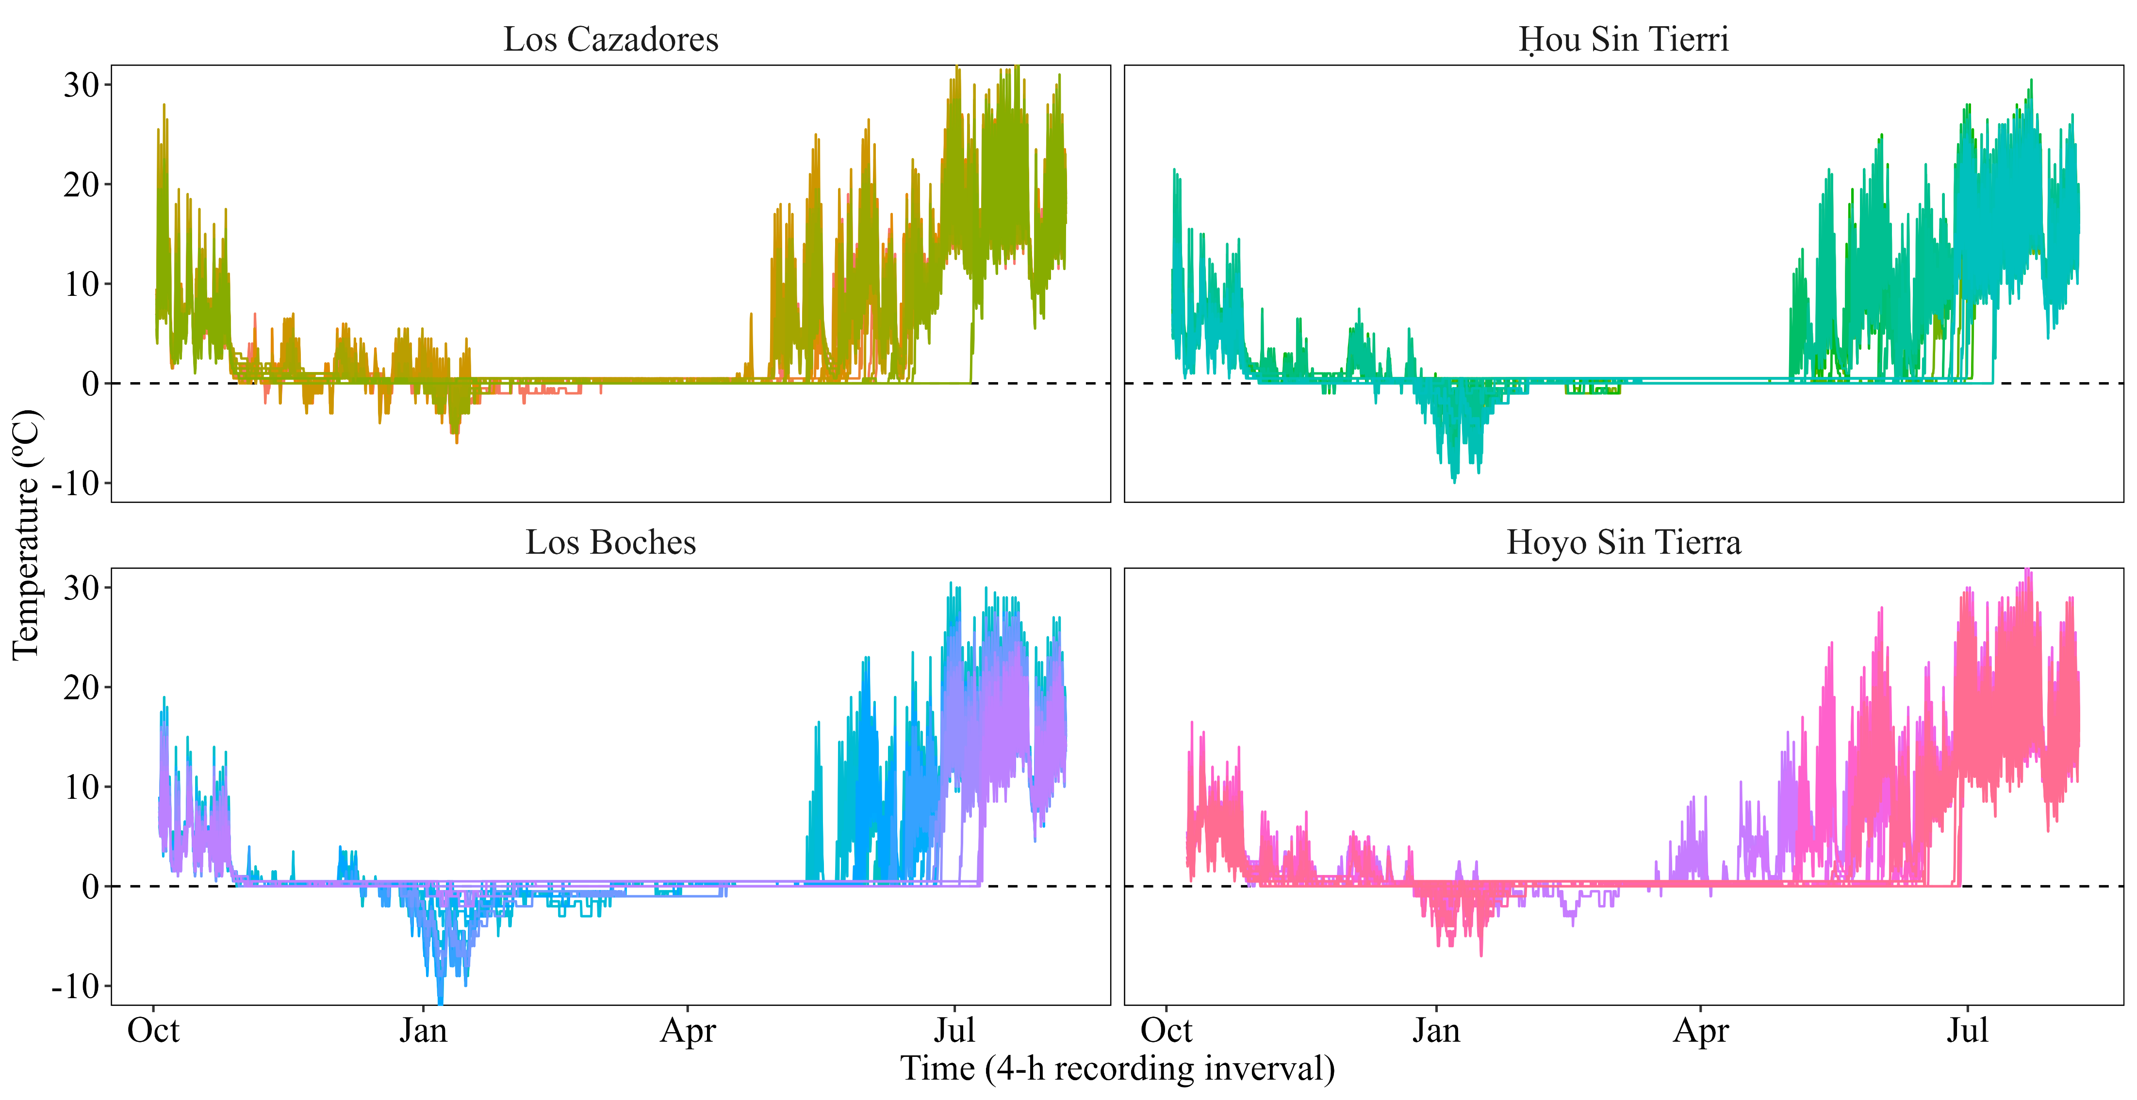
Microclimatic variation
Microspatial variation in soil temperature (n = 20 plots x 4 sites)

Slide 8
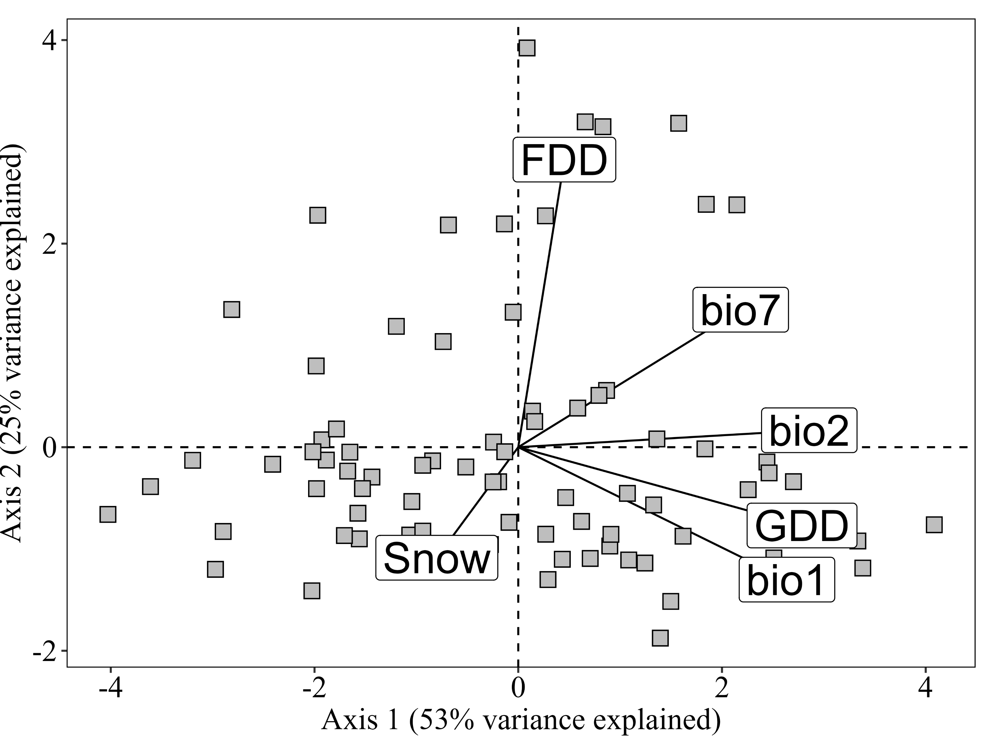
Microclimatic variation
PCA of bioclimatic variables (n = 20 plots x 4 sites)
bio1
Mean annual temperature
bio2
Diurnal temperature range
bio7
Annual temperature range
Snow
Days with snow cover (bio2 < 1ºC)
GDD
Growing degrees-day
Σ positive temperatures
FDD
Freezing degrees-day
Σ negative temperatures (absolute)
Frost risk
Warmth

Slide 9
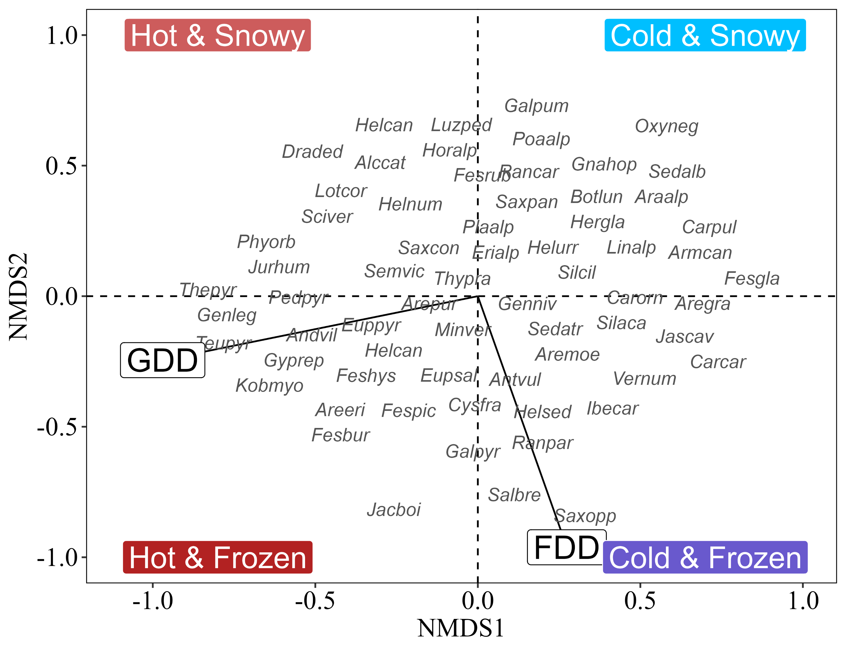
Plant diversity
NMDS of species composition (n = 20 plots x 4 sites)
Environmental fit
 | NMDS1 | NMDS2 | R2 | p
bio1 | -0.99 | -0.05 | 0.74 | 0.001 | ***
bio2 | -0.87 | -0.49 | 0.52 | 0.001 | ***
bio7 | -0.72 | -0.7 | 0.18 | 0.003 | **
Snow | 0.34 | 0.94 | 0.06 | 0.108
GDD | -0.97 | -0.24 | 0.78 | 0.001 | ***
FDD | 0.27 | -0.96 | 0.33 | 0.001 | ***

Slide 10

Plant-microclimate relationships
GLMs of species responses to microclimate
glm(Presence ~ GDD + FDD, family = "binomial)
Species with more than 10 occurrences
Significant predictors
McFadden’s pseudo R² > 0.15
Models fitted for 16 out of 81 (20%) species in the system
Hypothesis 1

Slide 11
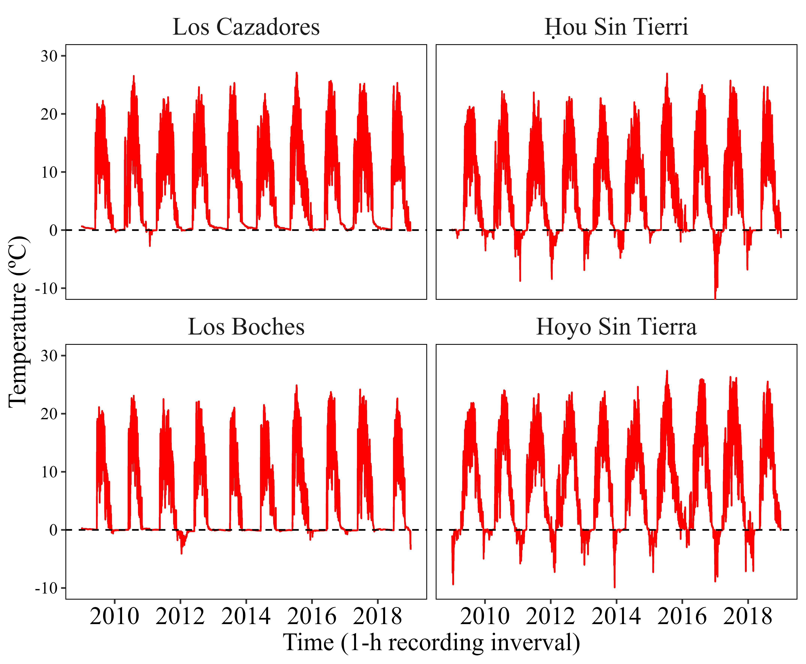
Plant-microclimate relationships
Climate change scenarios
Scenarios based on extreme annual GDD and FDD values recorded during the 10-year temporal survey
“extremes become new normal”

Slide 12
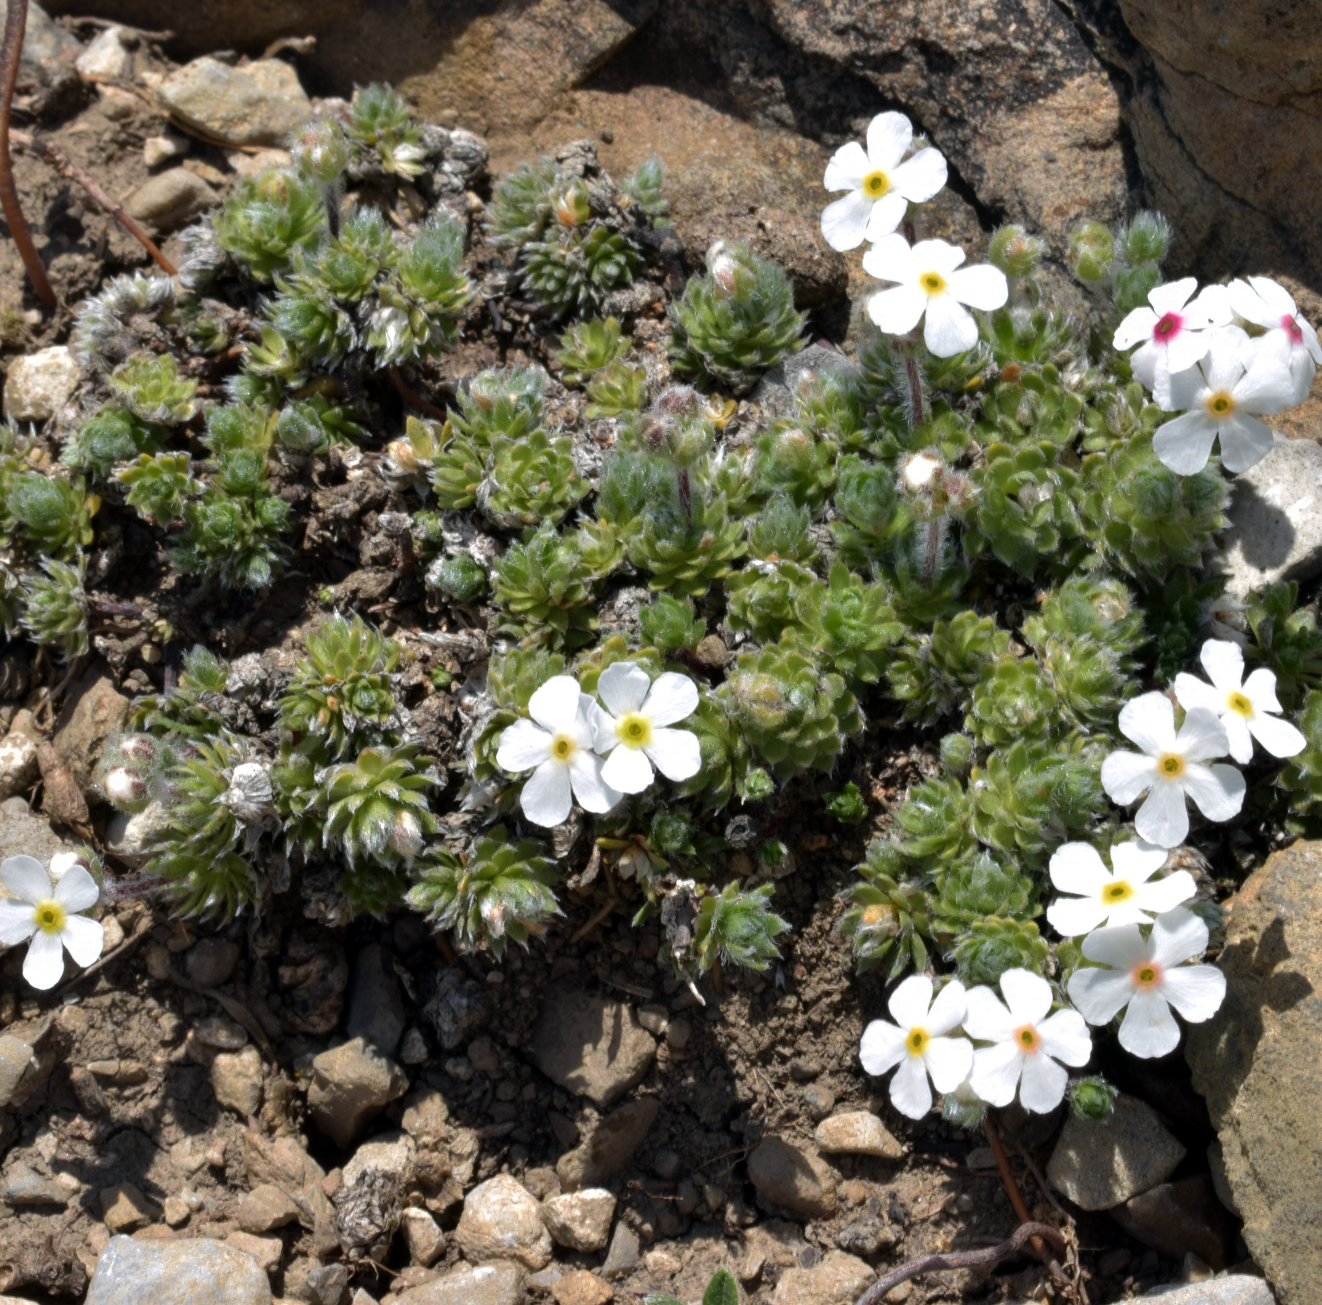
Plant-microclimate relationships
Warmth-loving species
Androsace villosa
Mountains of southern Europe & the Near East
Probability of extinction
Cold & Snowy = 100%
Cold & Frozen = 100%
Hot & Snowy = 0%
Hot & Frozen = 0%

Slide 13
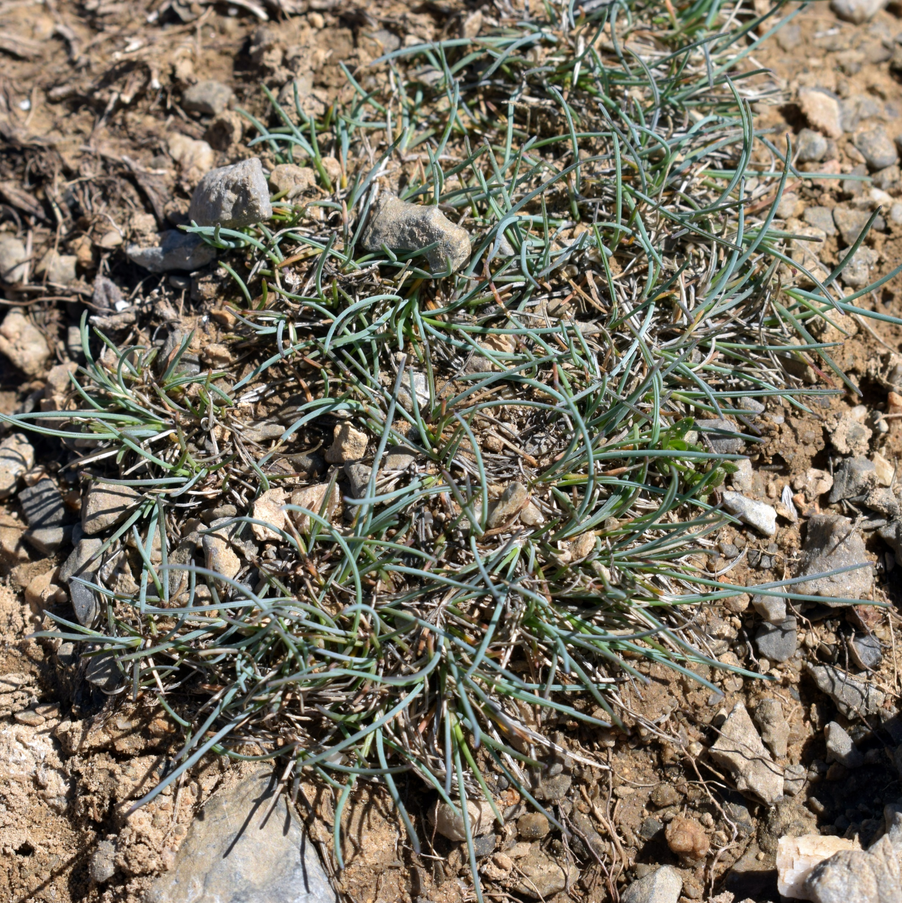
Plant-microclimate relationships
Cold-loving species
Festuca glacialis
Cantabrian Mts & Pyrenees
Probability of extinction
Cold & Snowy = 0%
Cold & Frozen = 0%
Hot & Snowy = 100%
Hot & Frozen = 100%

Slide 14
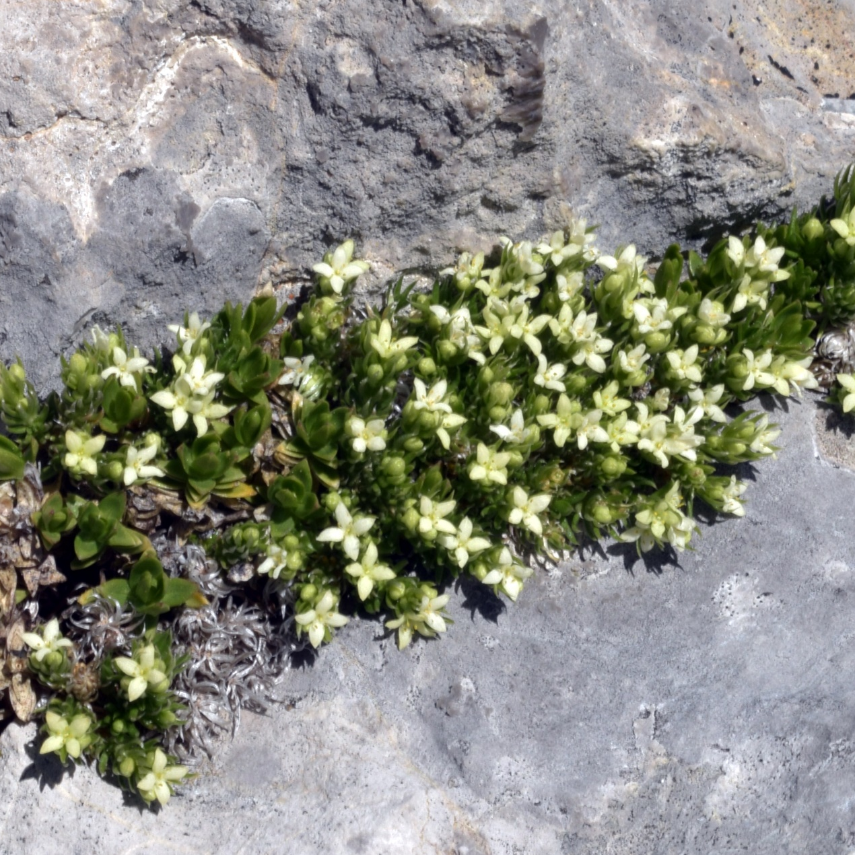
Plant-microclimate relationships
Frost-loving species
Galium pyrenaicum
Cantabrian Mts, Pyrenees,
Sierra Nevada
Probability of extinction
Cold & Snowy = 98%
Cold & Frozen = 5%
Hot & Snowy = 97%
Hot & Frozen = 4%

Slide 15
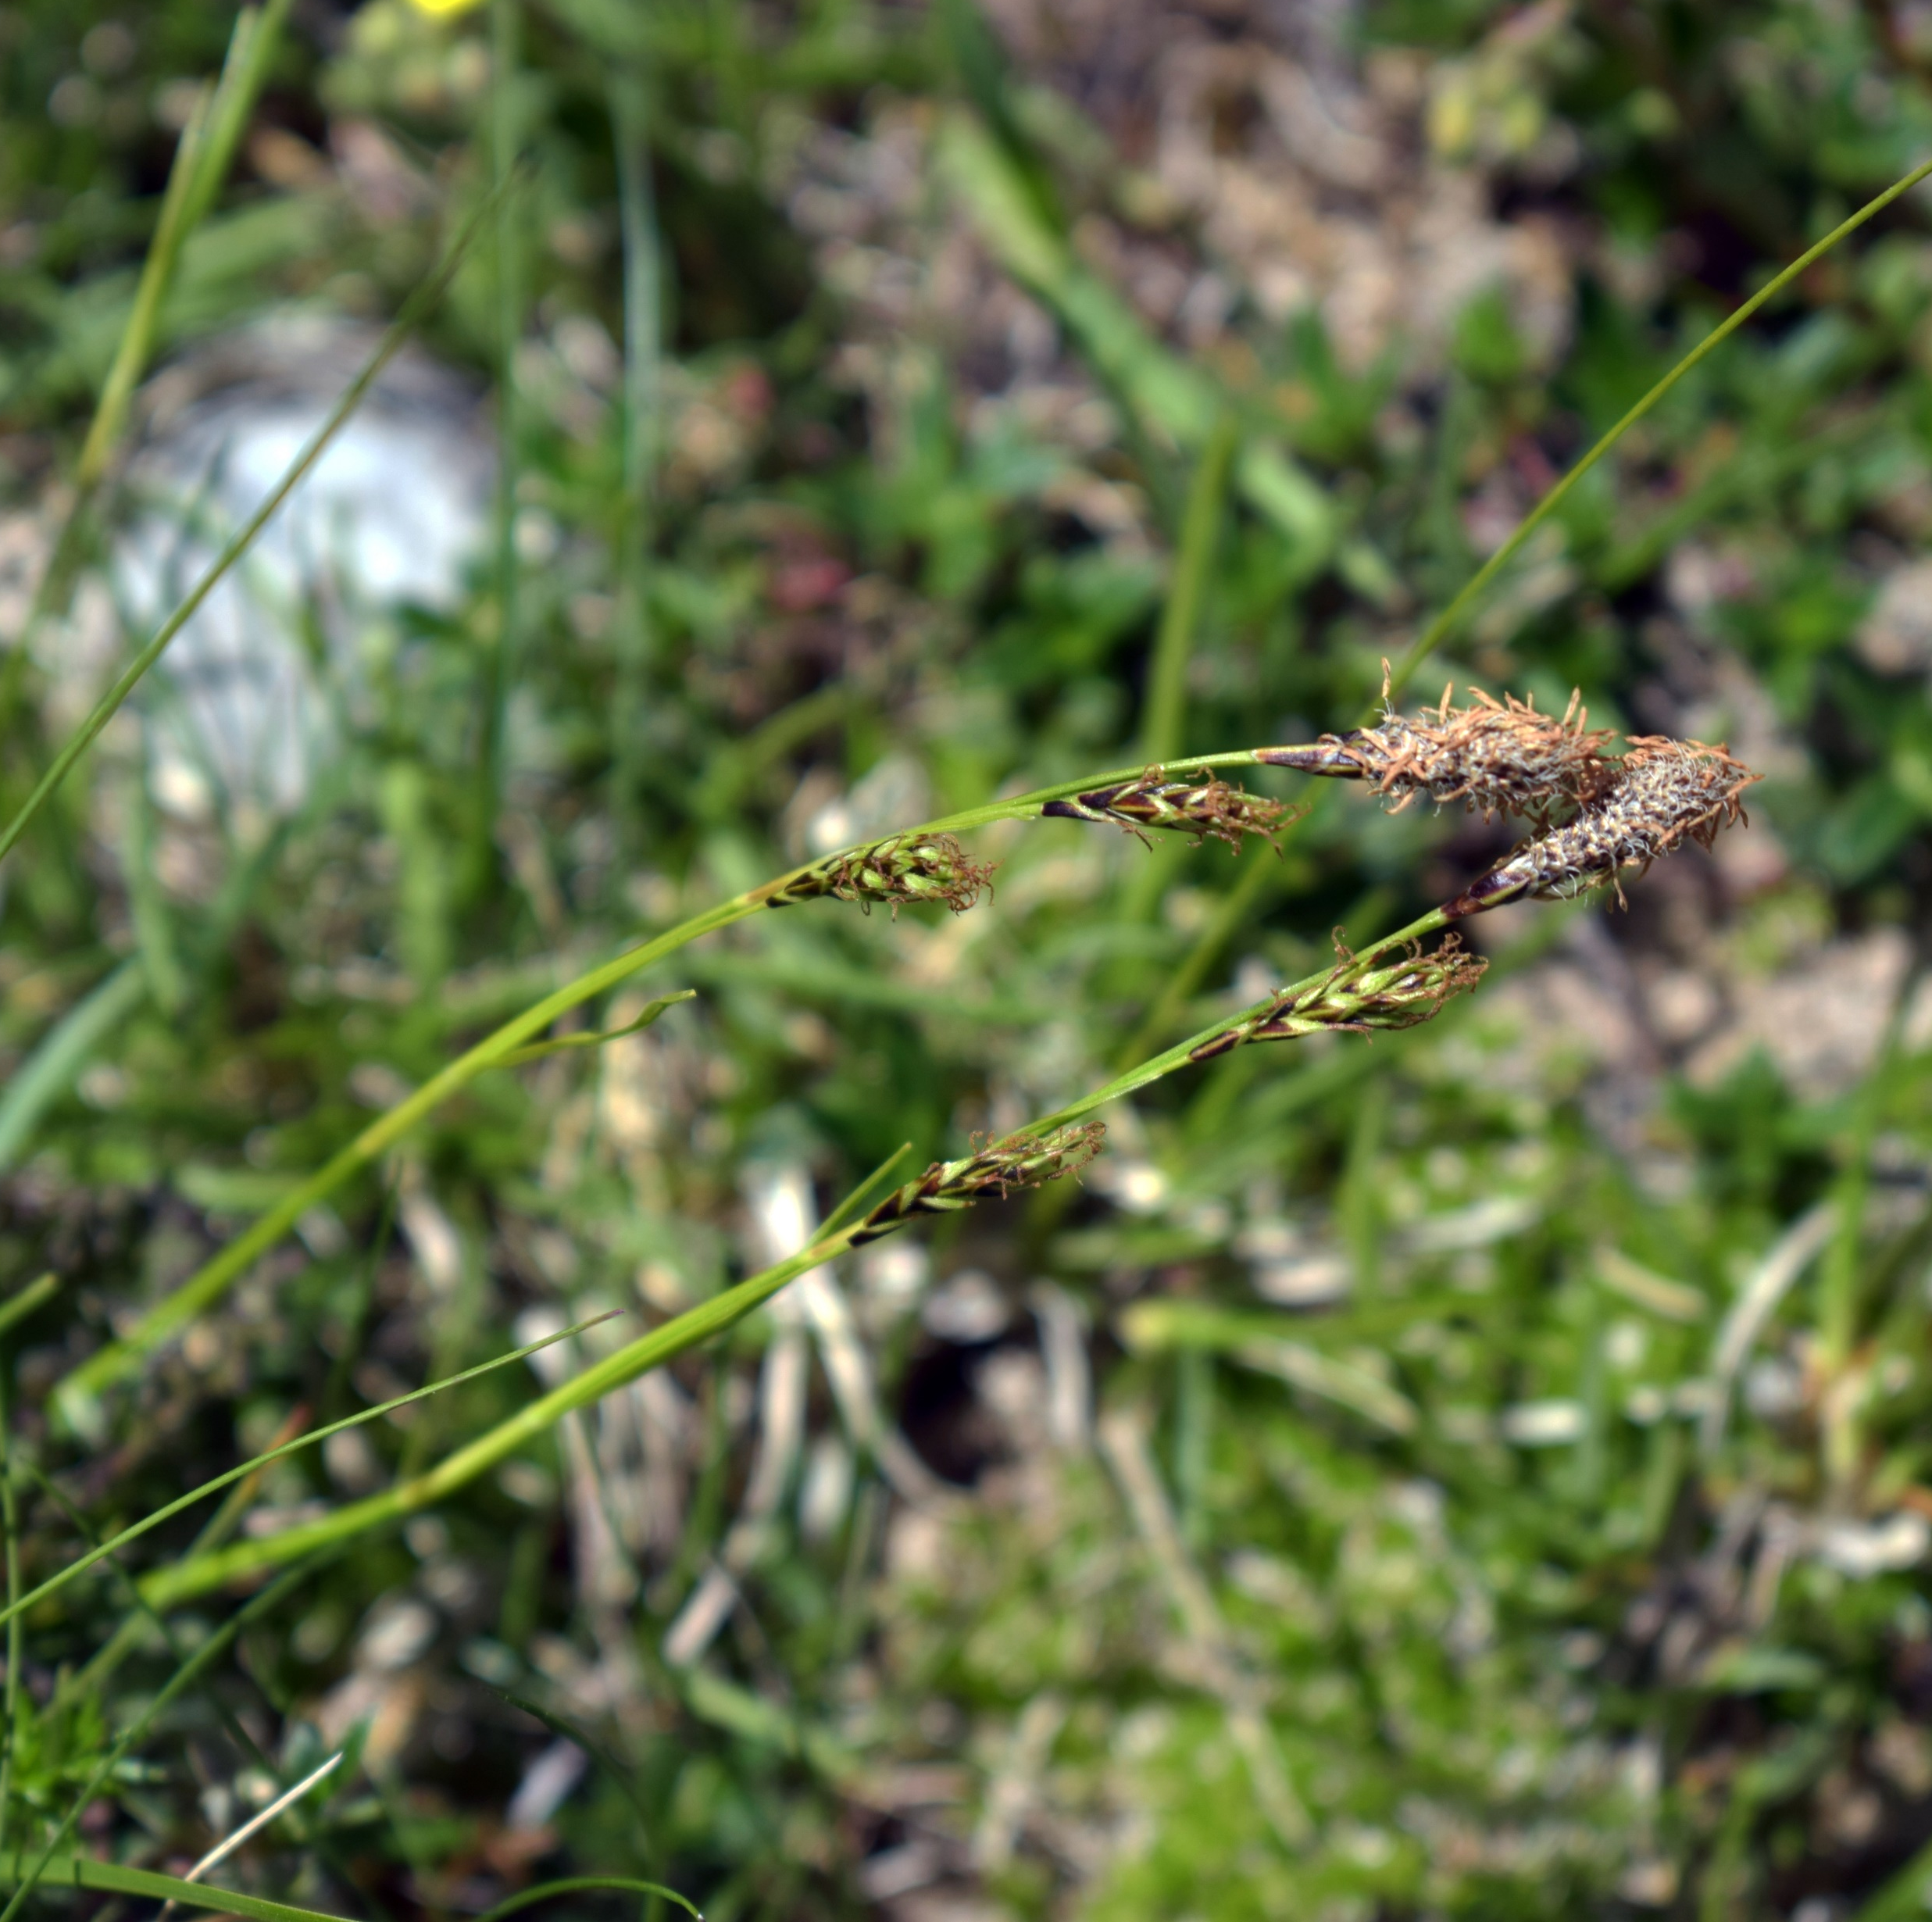
Plant-microclimate relationships
Snow & warmth-loving species
Carex sempervirens
Cantabrian Mts, Pyrenees,
Alps, Apennines, Carpathians
Probability of extinction
Cold & Snowy = 62%
Cold & Frozen = 99%
Hot & Snowy = 3%
Hot & Frozen = 64%

Slide 16
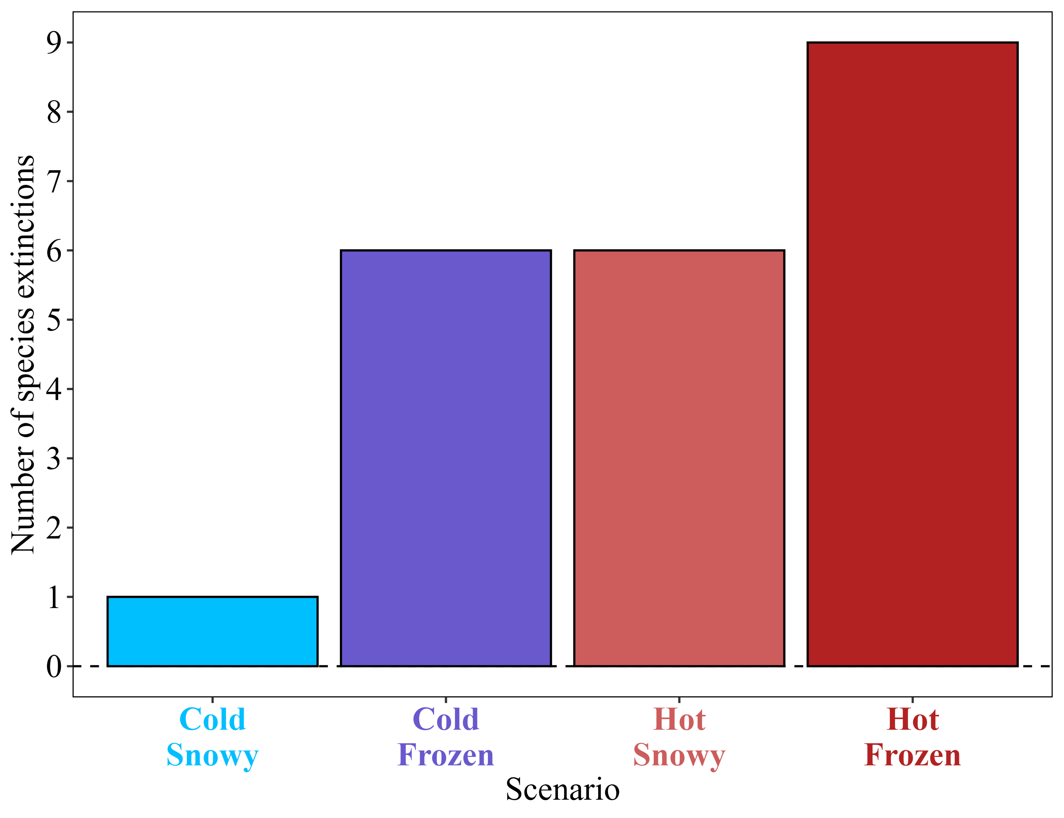
Plant-microclimate relationships
Extinction scenarios
Hot summers and frosty winters are associated to the highest number of species extinctions
Hypothesis 2

Slide 17
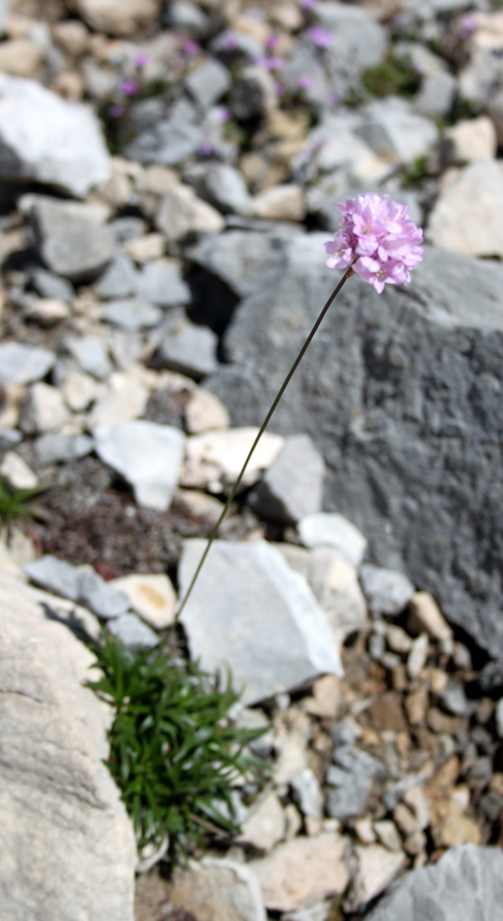
Conclusions
20% of the local species pool shows significant responses to microspatial climatic variation
1
An oromediterranean scenario with hot summers plus snow-free & frost-prone winters leads to the highest number of potential species extinctions
2
Assuming that warming is unavoidable, future snow patterns will determine the fate of the local alpine species pool
3
Armeria cantabrica

Slide 18
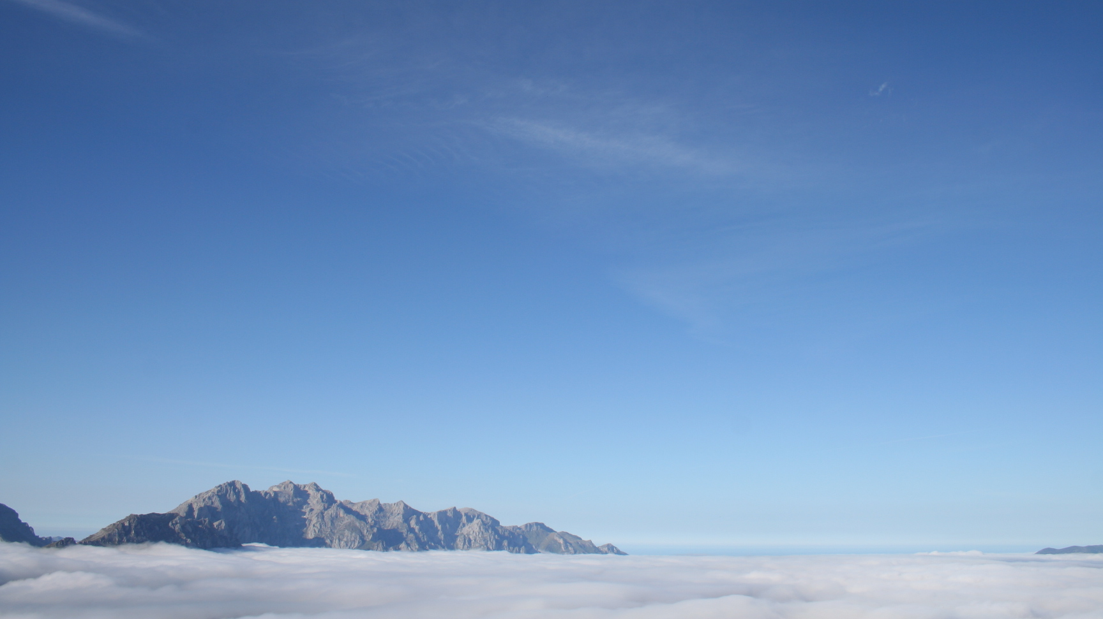








ACKNOWLEDGMENTS
Grants ACB17-19 & ACB17-26
Grant SV-20-GIJON-JBA
Grant MCI-20-PID2019-108636GA-I00
CONTACT
fernandezpeduardo@uniovi.es
Vegetation & Biodiversity Lab
www.jimenezalfaro.net
THANK YOU

